Slide 1
MODULE A UNIT A1

Slide 2


Slide 3

English has two articles: “the” and “a/an”. The is used to refer to specific or particular nouns; a/an is used to modify non-specific or non-particular nouns. We call “the” - definite article and “a/an” - indefinite article.

Slide 4
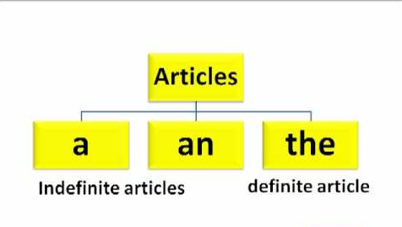
For example:
If I say, “Let's read the book.” (I mean a specific book)
If I say, "Let's read a book.," (I mean any book rather than a specific book)

Slide 5
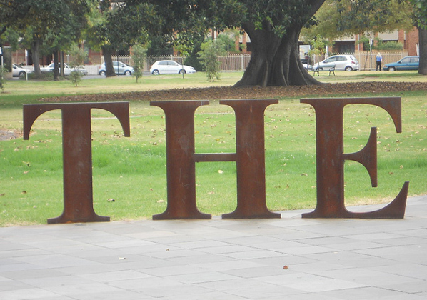
Definite Article
The main aim of the definite article is to identify ‘something/someone specific' to the reader or listener. “The” is used before singular and plural, feminine and masculine nouns when the noun is specific or particular. “The” signals that the noun is definite, that it refers to a particular person, object, place, etc. of a group.

Slide 6
"I was happy to see the police officer who saved my brother!"
Here, we're talking about a particular police officer. Even if we don't know the police officer's name, it's still a particular police officer because it is the one who saved my brother.

Slide 7
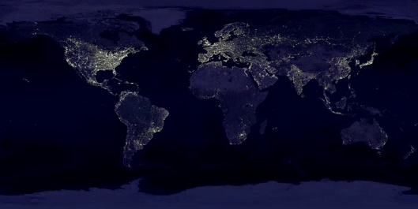
Geographical use of the
There are some specific rules for using
the with geographical nouns.
Do not use the before:
names of most countries/territories: Italy, Mexico, Bolivia; however, the Netherlands, the Dominican Republic, The Philippines, the United States.
names of cities, towns, or states: Seoul, Texas, New York.
names of streets: Washington Blvd., Main St.
names of lakes and bays: Lake Titicaca, Santander Bay except with a group of lakes like the Great Lakes.
names of mountains: Mount Everest, Mount Fuji except with ranges of mountains like the Andes or the Rockies.
names of continents: Asia, Europe, America.
names of islands: Easter Island, Maui, Key West, except with island chains like the Canary Islands, the Hawaiian Islands.

Slide 8

Use the before:
names of rivers, oceans and seas: the Nile, the Pacific
points on the globe:
the Equator, the North Pole
geographical areas:
the Middle East, the West
deserts, forests, gulfs, and peninsulas: the Sahara, the Persian Gulf, the Iberian Peninsula

Slide 9

Use the before:
names of musical instruments:
the guitar, the drums, the violin
in conjunction with a superlative form:
the most amazing, the cheapest
before nouns of which there is only one:
the sun, the president, the moon
before an adjective used as a noun to describe a class of people:
the English, the deaf, the French
UTN - FRVM Lic. Evangelina Cecchel - Lic. Bibiana Fernandez

Slide 10

Indefinite Articles
"A" and "an" signal that the noun modified is indefinite, referring to any member of a group. For example:
"Somebody call a police officer!"
This refers to any police officer. We don't need a specific police officer; we need any police officer who is available.

Slide 11
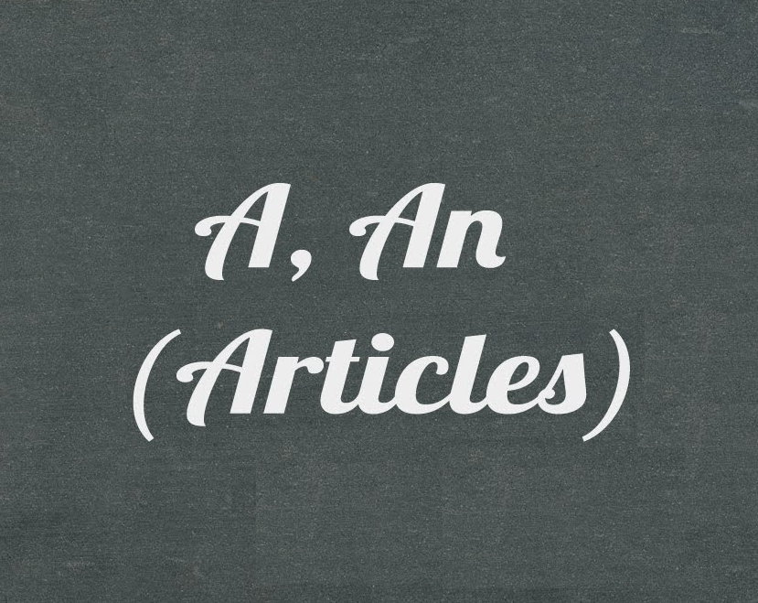
The article 'an' is used with common nouns beginning with vowel sounds. 'A' is used for the rest of the words. So...
a + singular noun beginning with a consonant: a boy; a car; a bike; a zoo; a dog
an + singular noun beginning with a vowel: an elephant; an egg; an apple; an umbrella; an orphan
an + singular noun beginning with a vowel sound:
An x-ray, an FBI agent
a + singular noun beginning with a consonant sound: a user; a university; a European, a one-month offer
an + noun starting with silent "h":
an hour, an honor, an heir
a + noun starting with a pronounced "h":
a horse, a hospital

Slide 12
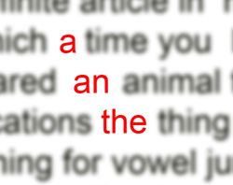
Use the indefinite article a/an…
before phrases of time and measurements:
We have English 4 times a week.
I go on holiday twice a year.
before phrases of jobs:
My father is a car mechanic.
with a noun complement:
He is a good boy.
before phrases of nationality:
Bruce Springsteen is an American.
half/quite:
We need half a pound of sugar.
This is quite a good story.

Slide 13

ABBREVIATIONS AND ACRONYMS
While using an article with abbreviations, it gets a little tricky. The first thing to do is to figure out if the abbreviation is an acronym (pronounced as one word) or letter-by-letter. For example, HIV (human immunodeficiency virus) is pronounced letter-by-letter but the acronym AIDS (acquired immunodeficiency syndrome) is pronounced as one word. Then, depending on the initial sound of their pronunciation, appropriate articles can be used.

Slide 14

Example:
It would be right to say ‘a Masters in Business Administration’. But, if you were using the abbreviation, it would be ‘an MBA’, as it is an abbreviation.
Other examples: an EFL student, an NBC reporter, an NBA coach, an SOS, a US senator, a UN mission.

Slide 15
Exceptions for using Articles
There are exceptions in English grammar that limits or prohibits the use of articles.
a. While mentioning countries Example: 1. China is an important super power. 2. She has just returned from Korea.

Slide 16
b. While mentioning languages Example: 1. German is spoken in Germany. 2. English has many words of French origin. c. While mentioning years Example: 1. India gained independence in 1947. 2. World War II ended in 1945. There are more categories that you will come across while practicing consistently.

Slide 17
Choose ‘a’ or ‘an’ in the following examples.
This is a / an unusual problem but there is a / an unique way of solving it.
This show will last for a / an hour and a / an half.
Why are you wearing such a / an old outfit?
Can you call a / an doctor?
The king needed a / an heir to his throne.
A / An MBA is a / an Master of Business Administration degree.
Charlie spent his entire childhood as a / an orphan.
I have a / an $ 5.00 bill with a / an red seal on it.

Slide 18
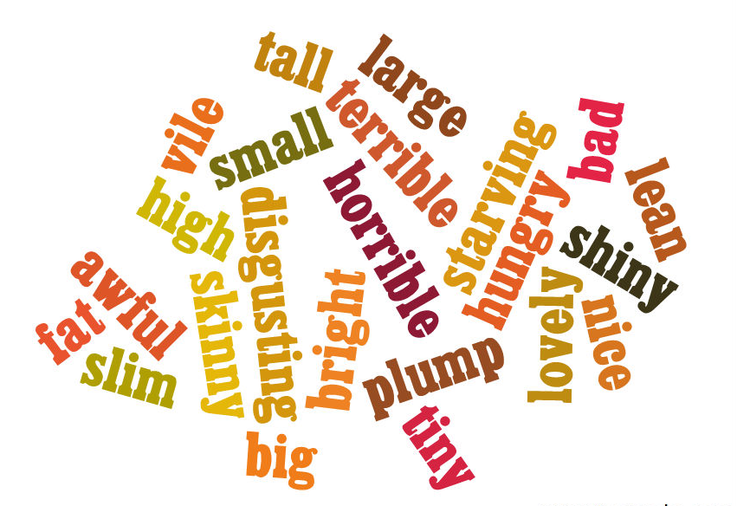
ADJECTIVES

Slide 19

An adjective is a word that tells us more about a noun. (By "noun" we include pronouns and noun phrases.)
An adjective "qualifies" or "modifies" a noun:
A new student.
An interesting book.
Adjectives can be used before a noun:
I like Chinese food.
…or after certain verbs (verb be and other non-action verbs: look, seem, sound, smell, taste, appear):
That moment was memorable.
He looked enthusiastic about the project.

Slide 20

Adjectives do not have plural forms:
An expensive car.
Expensive cars.
We can often use two or more adjectives together. If we use more than one adjective to describe a noun we have to consider a particular word order of adjectives used before a noun.
A beautiful modern French painting.

Slide 21
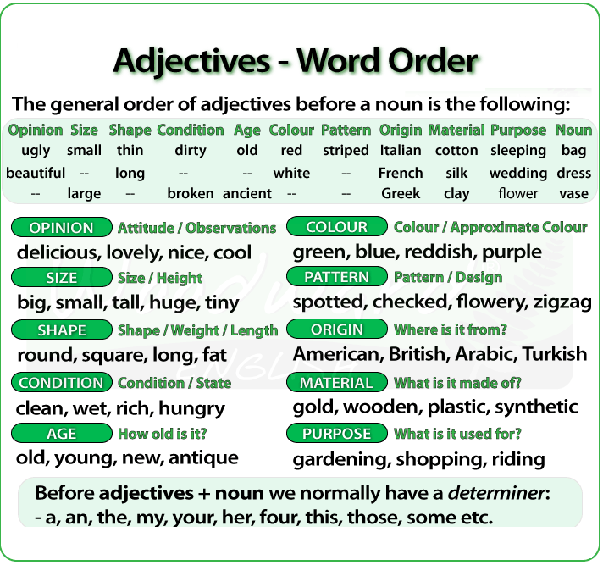

Slide 22
Before the adjectives you will normally have a determiner.
Determiner: The determiner tells us if the noun is singular or plural, definite or indefinite: a, an, the, my, your, four, those, some, etc.
After the determiner we have the adjectives that refer to…
Opinion: these adjectives explain what we think about something / someone (opinion, attitude or observation). These adjectives almost always come before all other adjectives: beautiful, boring, delicious, useful, lovely, comfortable, etc.

Slide 23
Size: these adjectives tell us how big or small something is: big, small, tall, huge, tiny, etc.
Shape / Weight / Length: they tell about the shape of something or how long or short it is. They can also refer to the weight of someone or something: round, square, circular, skinny, fat, heavy, straight, long, short, etc.

Slide 24
Condition: these types of adjectives tell us the general condition or state of something: broken, cold, hot, wet, rich, easy, difficult, dirty, etc.
Age: they tell us how old someone or something is: old, young, new, ancient, antique, modern, etc.
Color: the color or approximate color of something: green, white, blue, reddish, purple, etc.

Slide 25
Pattern: the pattern or design of something: striped, spotted, checked, flowery, etc.
Origin: these adjectives tell us where something or someone is from: American, British, Italian, eastern, Australian, Chilean, etc.
Material: What is the thing made of or constructed of?: gold, wooden, silk, paper, synthetic, cotton, woolen, etc.

Slide 26
Purpose/Qualifier/Use: What is it for? These adjectives often end in –ing: sleeping (bag), gardening (gloves), shopping (bag), wedding (dress), etc.
Noun: The person or thing that is being described.
IMPORTANT: The order of adjectives before a noun IS NOT FIXED. You may see or hear slight variations of the order of adjectives in real life though what appears in the chart we have analyzed is the expected order of adjectives. Another important thing to have in mind is that it does not sound natural using three or more adjectives in the same sentence and it is very rare to hear four adjectives together before a noun.

Slide 27
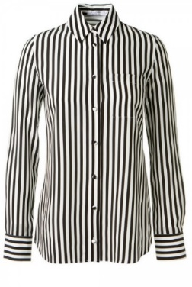
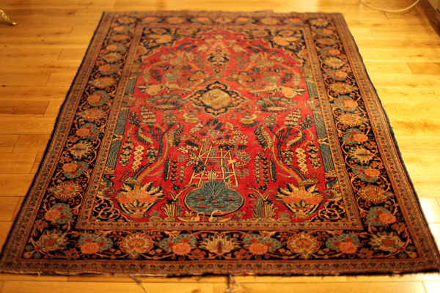
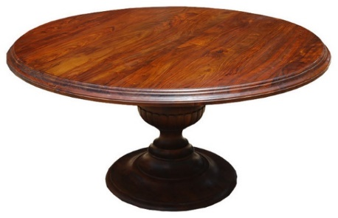
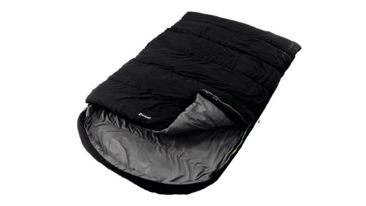
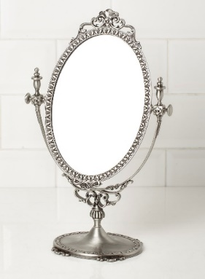
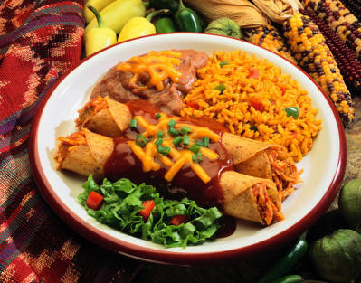
Some examples:
An interesting old Indian rug.
A striped silk shirt.
Some comfortable black sleeping bags.
Four small round wooden tables.
An expensive antique silver mirror.
Delicious Mexican food.

Slide 28


Slide 29
Definite and indefinite articles:
http://www.ompersonal.com.ar/omgrammar/articulos.htm
http://www.ompersonal.com.ar/omgrammar/articulos2.htm
http://www.ompersonal.com.ar/INTERMEDIATE/unit16/page3.htm
http://www.ompersonal.com.ar/INTERMEDIATE/unit16/page4.htm
Review of adjectives:
http://www.ompersonal.com.ar/omgrammar/adjetivoscalificativos.htm
http://www.ompersonal.com.ar/INTERMEDIATE/unit4/page1.htm
Order of adjectives:
http://www.aulafacil.com/cursos/l22488/idiomas/ingles/ingles-repaso-de-gramatica/ejercicios-orden-de-los-adjetivos
http://www.ejerciciodeingles.com/orden-adjetivos-descriptivos-ingles/

